Slide 1
WELCOME

Slide 2
CNG Leakage Alert System
Presented by:
Arya Ambekar.
Sanika Dali.

Slide 3
Table of Content
Problem Statement
Introduction
Hypothesis
Objectives
Methodology
Components
Survey
Limitations
Conclusion

Slide 4
Problem Statement
CNG leakage is becoming a big problem these days and if there is a small leakage, it is not even noticeable that’s why the vehicles can have problems like low mileage or some blast etc.

Slide 5
Introduction
In proposed system it will generate an alert after detecting a CNG leakage from tank and subsequently send a message to the driver of the vehicle.

Slide 6
Hypothesis
If CNG Leakage Alert System is design or implemented in vehicle then it will be helpful to detect the CNG leakage and also it will solve the consequent problems.

Slide 7
Objectives
To detect Gas Leakage like(CNG) using MQ4 sensor and Arduino.
To send the SMS(alert messages) to specified mobile numbers.
In danger situations we are able to save the life by using this system.
An alert is indicated by the GSM Module

Slide 8
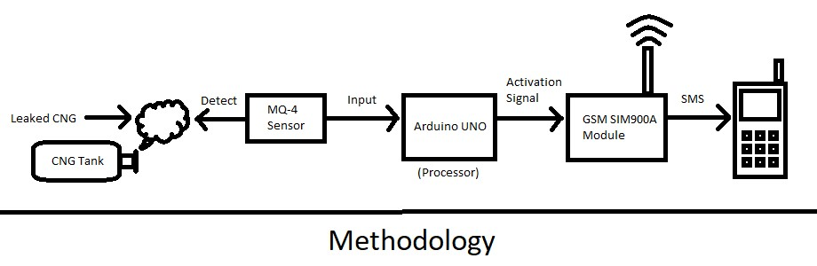
Methodology

Slide 9
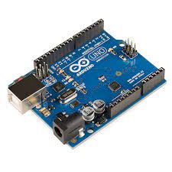
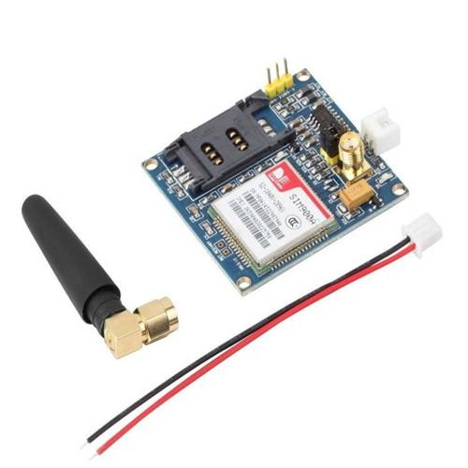

Components
Arduino
GSM SIM900A Module
MQ-4 Sensor

Slide 10
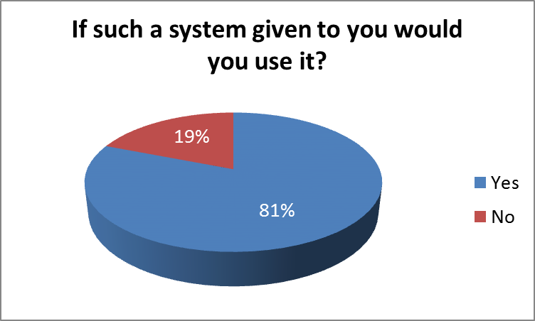
Survey

Slide 11


Limitations
Range problem
Rarely available 2G SIM

Slide 12
Conclusion
We can conclude that if there is a CNG leak then this system will detect.
After CNG gas leakage is detected it will send the alert message to the user via GSM module.

Slide 13
Thank You

